Slide 1


TOPIC NAME
STUDENT’S NAME
COURSE CODE
PROFESSOR’S NAME

Slide 2
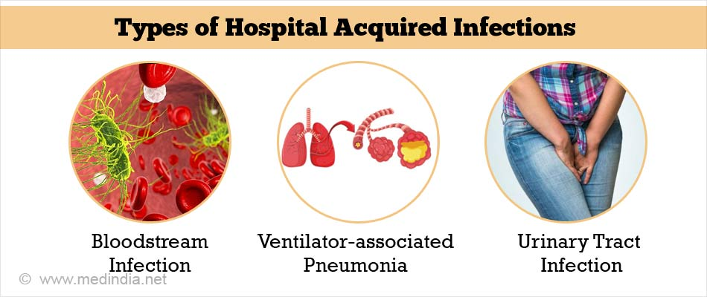
HOSPITAL-ACQUIRED INFECTIONS
Notes:
Hospital Acquired infections or HAI are some common illnesses that are acquired by a patient when the visit or get admitted to any hospital for the treatment or surgery of any other disease. These infections can be spread by Hospital staffs, patients, instruments, air, contaminated food and water. So this has become a major problem these days. In order to fight this problem, interdisciplinary approach has been taken where experts and experienced people from various domains come forward and together find solution to eradicate this problem.

Slide 3
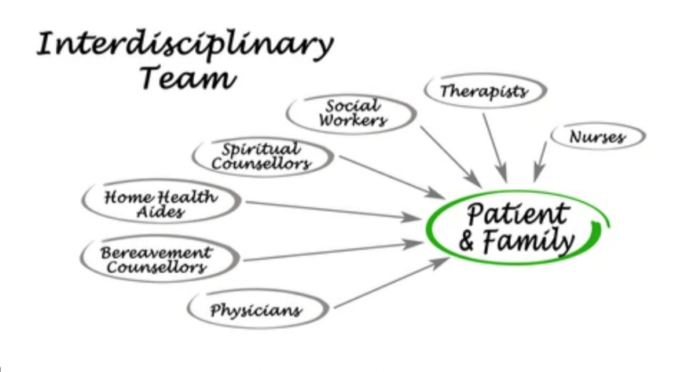
ReLEVANCE OF INTERDISCIPLINARY TEAM APPROACH
Why is using an interdisciplinary team relevant, or the best approach, to addressing the issue?
Diverse Knowledge.
More Expertise.
Better Prevention of HAI
Notes:
With the increase in the complexity of diseases in our day to day life, the need of the collaboration all health as well as other departments has become inevitable to fight the disease effectively. This inter disciplinary team approach brings all the expertise of various domains together that creating a huge pool of knowledge and experience that leads to fight the diseases in the best possible way. In addition to that, the exponential growth in severity of diseases all around the world, it becomes extremely difficult for a single medical institution to tackle the situation in an effective manner. Therefore, Interdisciplinary team approach would be the best defense.

Slide 4
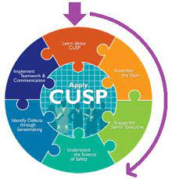
ReLEVANCE OF INTERDISCIPLINARY TEAM APPROACH
How will this interdisciplinary approach reach it’s goal?
By applying Comprehensive Unit-Based Safety Program
Team Work
With availability of sufficient resources.
Notes:
Interdisciplinary approach will reach it’s goal by following practices: 1) By implementing infection control practices by medical and nursing staffs. 2) Organizing seminars and webinars to create awareness and spread knowledge about HAI. 3) Specialized trainings should also be held. 4) By implementing CUSP 5) Need to make sure that proper availability of resources.

Slide 5
INTERDISCIPLINARY PLAN SUMMARY
OBJECTIVE
ROLE OF INTERDISCIPLINARY TEAM
HOW MUCH EFFECTIVE?
Notes:
Interdisciplinary plan is basically various departments coming together and putting their best of ideas in front to together solve any global issue. Since here we are talking about the prevention of HAI so we will discuss the main plan of interdisciplinary action focusing to prevent HAI. We divided the plan of this interdisciplinary approach in 3 parts namely Objective, Effectiveness and it’s Role, so that would be easy to discuss. Brief description of each of these are in the upcoming slides.

Slide 6
OBJECTIVES:
To understand the effectuality of CUSP.
To enhance patients’ health outcomes.
Increase Patient safety.
Reduce medical expenses of common men.
Reduce re-admission in hospitals
Notes:
Comprehensive Unit based safety program, commonly known as CUSPS is a proposal of interdisciplinary approach which focusses on enhancing patients’ health and keep a track of the fact that patient need not to stay in the hospital. This is because the longer the duration in the hospitals, more are the chance to get infected by ‘ Hospitals Acquired infections’(HAI). Also it checks that the patient need not to get re-admitted in the hospitals due to HAI. And all these problems can only be dealt with a good team work, with obviously the team members of different disciplines working under any experienced personality.

Slide 7
EFFECTIVENESS:
MOST EFFECTIVE METHOD
Interdisciplinary approach to prevent or lower HAI.
Notes:
Till date interdisciplinary approach is found to be the most effective way to fight HAI. The reason is specialized trainings are there to prevent to take special care of patients who are more prone to these HAI, like elderly people are more easy to get affected by these diseases. Beside, there is effective communication among the members of different domains. Work is conducted under any expert. Also when people of diverse disciplines come forward, they definitely put up their diverse ideas with together combine to give the best solution of any problem.

Slide 8
ROLE OF INTERDISCIPLINARY:
Team Work
Change in leadership approach.
Effective Communication
Notes:
Team work implies at least one member of each care team come forward to make a team of 6to 8 people who will work under the guidance of any project manager. The project manager allocates duties and that is need to be performed by the individual members. Change in leadership approach implies that the strategies undertaken should be adaptive according to situations and can be changed to better when needed. Effective communication among the various stakeholders will help in the choice of the required change management theories and leadership approaches.

Slide 9
IMPLEMENTATION AND RESOURCE MANAGEMENT
RESOURCES
Nurses
Lab technicians
Seminars
Money
Trainings
Doctors
Notes:
To implement inter disciplinary approach in the most successful manner there should be the presence of sufficient resources, both human resources, materialistic resources as well as monetary resources. The more the no. of doctors, Nurses and lab technicians, the better the identification of disease can be done and better care of the patients can be taken. Again, regular seminars, webinars and trainings should be there to upskill the new batches of doctors, nurses and lab technicians. And for all these require monetary support, therefore money is also counted as an important resource of the inter disciplinary approach.

Slide 10

Resource expenditure
Notes:
Implementation of Interdisciplinary approach doesn’t require a huge amount of extra money, this is because the patient access department is already existing in all hospitals. And this thing reduces a lot of money pressure. The only minimal amount is required for planning and training purpose. Beside if we think standing the shoes patient party, then it is benefit for them too. If a patient does not gets HAI, then he need not to bear any extra medical charges. So it is overall a success regards of monetary support.

Slide 11
EVALUATION
HAI count is less.
Less cases of re-admission.
Effective solutions for various HAI.
Notes:
With regular research and successful implementation of CUSP has found that there is reduction in cases of hospital acquired infection and readmission. Even though the chances of infection of elderly people were more but this was also taken under control with proper monitoring and care. This also reduced the medical expenditure of common men. So, after analyzing and examining all the active factors and relevant details, it can be rightfully concluded that it can be considered as an overall success.

Slide 12
References
Smith, A. George, 2015. Capstone interdisciplinary team project: a requirement for the MS in sustainability degree. International Journal of Sustainability in Higher Education.
Gamache, Susan J., 2015. Family Peacemaking with an Interdisciplinary Team: A Therapist's Perspective. Family Court Review.
Pare, Guy, 2011. Health Care IT: Process, People, Patients and Interdisciplinary Considerations. Journal of the associations for the Information Systems.

Slide 13


